Slide 1
Customer Insights for Bike Store Chain
Michael Collins 13.4.22

Slide 2
Outline
Deliverables and Data Source
Choosing key measurable factors
Analysis process
The dashboards
What we can learn now & in the future
Summary

Slide 3
Deliverables and Data Source
Deliverable: Create dashboards that stakeholders can use to better understand their customers. Who bought bikes and who didn't after visiting one of their stores.
Data Source: Customer survey gathered by the company. Unknown time frame.

Slide 4
Choosing key measurable factors
Did they make a purchase?
Demographic information: Marital status, region and level of education.
Further demographics and financial factors: gender, age, commute distance, income, occupation, number of children an cars.

Slide 5
Analysis process
Removed duplicates (26 rows removed) and some other cleaning.
Created brackets for ages and incomes to allow for grouping the data.
Created pivot tables and charts for each of the driving factors.
Grouped pivot charts and added slicers to allow you to look at individual demographics.

Slide 6
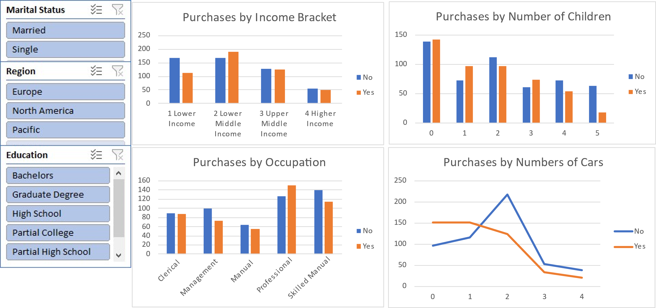
The dashboard – financial factors

Slide 7
What we can learn: Income brackets

Slide 8
What we can learn: Income brackets for single customers by region

Slide 9
What we can learn: Income brackets for single customers by region

Slide 10
What we can learn: Income brackets for single customers by region

Slide 11
What we can learn: Income brackets for single customers by region

Slide 12
What we can learn: Occupation Type

Slide 13
What we can learn: Occupation Type
Most likely to make a purchase:
Clerical and Manual occupations
Professional and Skilled Manual occupations
Professional and Management occupations

Slide 14
Summary
The three regions show different purchasing profiles: Most value can be gained by looking at each region separately to see what is true for them.
Europeans are more likely to purchase if they have a lower income, shorter commute, and no car.
North America shows a trend towards a more affluent customer with a longer commute.
In the Pacific, the customer is more likely to be female, and more women with a higher income don’t buy bikes than do. This is a gap in the market for us.

Slide 15
Limitations
Differences between regions may be due to store location or cultural factors. Further data would be needed to better understand this.
The data only measures if a customer made a purchase, not how much they spent.
This data is based on questionnaire respondents. There is no data to say whether they are indicative of the local populations or our bike store customers.

Slide 16
Thank you
Michael Collins
m.collins.data@gmail.com

